Slide 1

Lecture 1A:
AI For Science
Introduction to Machine Learning

Slide 2

Course Learning Objectives
Understand the foundational principles of artificial intelligence.
Explore the intersection of AI with various scientific disciplines.
Recognize the potential and limitations of AI in scientific research and applications.
Develop hands-on experience with simple AI tools and projects.
Cultivate a critical mindset towards the ethical considerations and consequences of AI in science.
AI For Science
Notes:
Please review the topics that we will be covering over the next 6 weeks, as they represent an overview of AI and its application in science.

Slide 3
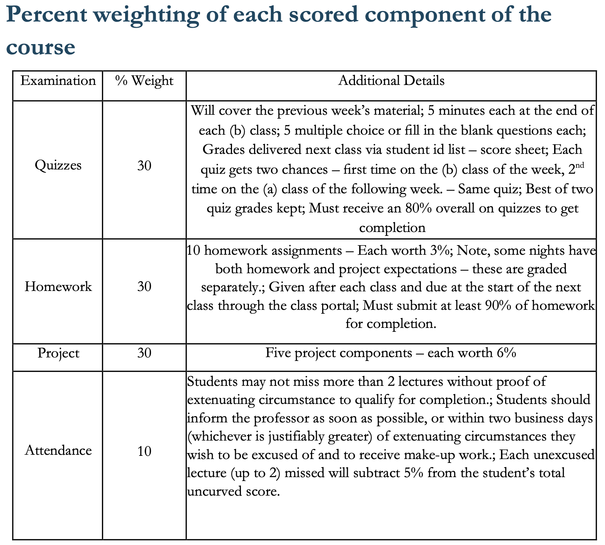
Syllabus
Professor:
Mr. Nagi Abouhussein
Course Director and Project Manager:
Dr. Jessica Freeze
Google Classroom
Class Code - jntrlzs
All assignments,quizzes, projects, and questions not handled during lecture will be submitted via the Google Classroom.
AI For Science
Notes:
Please review the topics that we will be covering over the next 6 weeks, as they represent an overview of AI and its application in science.

Slide 4
Classroom Expectations
Pay attention - In education, you get what you give so…
Get curious and ASK QUESTIONS! - Early and often
Let us know if you want to learn more about a topic. -We can adapt and provide additional resources!
Dr. Freeze has taught this material to students from middle school to professors at top universities.
Let us know if you need help.
AI For Science
Notes:
Please review the topics that we will be covering over the next 6 weeks, as they represent an overview of AI and its application in science.

Slide 5
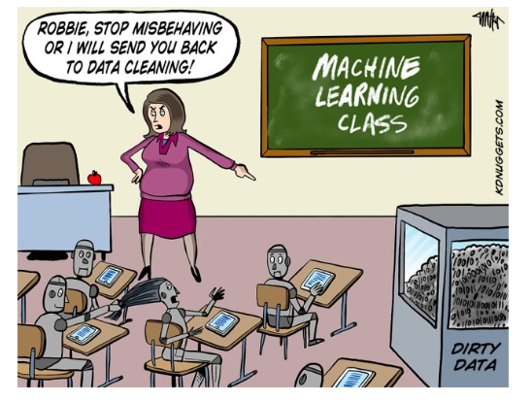
1A. Introduction to Machine Learning
What is AI?
What is the history of AI?
How does machine learning fit in AI?
AI For Science
Notes:
What is AI?
AI stands for Artificial Intelligence:
AI refers to machines or computer systems that can perform tasks that typically require human intelligence.
These tasks include things like recognizing patterns, learning from experience, solving problems, and even understanding language.
Key abilities of AI systems:
Learning: AI can learn from data or experiences.
Reasoning: AI can make decisions based on information.
Problem-solving: AI can find solutions to complex issues, often faster than humans.
Perception: AI can understand the world through sensors (like cameras or microphones).
Examples of AI in everyday life:
Voice assistants like Siri or Alexa.
Self-driving cars.
Video games that adapt to the player’s skill level.
What is the History of AI?
Early Concepts (1950s):
Alan Turing: A British mathematician who asked the famous question, "Can machines think?" He developed the Turing Test, a way to measure if a machine's behavior is indistinguishable from that of a human.
1960s–1970s:
Early AI programs were created to solve specific problems, like playing chess or solving math equations.
Shakey the Robot: One of the first robots with AI that could move and make decisions based on its surroundings.
1980s–1990s:
AI experienced setbacks (known as "AI winters") because technology wasn’t advanced enough to support complex systems.
Development of expert systems: Programs that could make decisions in specialized fields like medicine.
2000s to Now:
AI has made a comeback due to advancements in computing power and the availability of large datasets.
Modern AI systems now power search engines, social media recommendations, and many smart devices.
How Does Machine Learning Fit into AI?
Machine Learning (ML) is a branch of AI:
Instead of programming every task, ML allows computers to learn from data and improve their performance over time.
How it works:
You give a machine lots of examples (data), and it finds patterns or rules without being explicitly told what to look for.
Example: Teaching an AI to recognize pictures of cats by showing it thousands of images, instead of describing what a cat looks like.
Relationship between AI and ML:
AI is the big picture, and ML is a tool used to make AI systems smarter.
Think of AI as the brain and machine learning as the method that helps the brain get better at certain tasks.

Slide 6
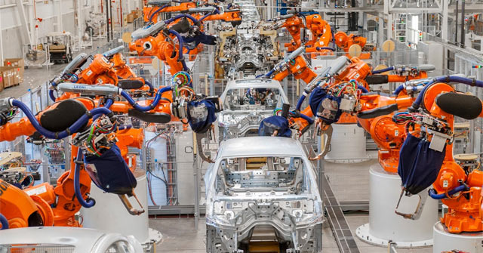
What is and isn’t artificial intelligence (AI)?
Simulating human intelligence
Human intelligence: rationality, optimality, neuroscience
Are robots AI?
Are industrial robots AI?
Haophuong21, CC BY-SA 4.0 https://creativecommons.org/licenses/by-sa/4.0 via Wikimedia Commons
AI For Science
Notes:
Simulating Human Intelligence
Goal of AI:
The main goal of AI is to simulate human intelligence—basically, to make machines think and act like humans.
How does AI simulate human thinking?
Learning: Just like humans learn from experiences (like studying or practicing), AI can learn from data and improve over time.
Decision-making: AI tries to make decisions based on the information it gets, much like how we use logic or reasoning to solve problems.
Solving problems: AI can take on complex challenges and find the best solutions, similar to how a human might approach a tough math problem or a puzzle.
Examples of simulating human intelligence:
Chatbots that have conversations with people (e.g., customer service bots).
AI assistants like Siri or Alexa that understand and respond to commands.
Human Intelligence: Rationality, Optimality, Neuroscience
Rationality:
Being rational means using logic and reasoning to make decisions.
Humans (and AI) try to be rational by analyzing facts and making the best possible decision based on available information. AI uses this approach to solve problems.
Optimality:
Optimality refers to finding the best or most efficient solution to a problem.
AI is designed to find the optimal answer, sometimes even faster and more accurately than humans.
Neuroscience:
Neuroscience is the study of the brain and how it works.
AI researchers study how the human brain processes information and use that understanding to design AI systems.
For example, neural networks, a type of AI, are modeled after how neurons (brain cells) work in our brains.
Are Robots AI?
Not all robots are AI, but they can be:
Robots are machines that can perform tasks, but they don't always have intelligence.
For example, a robot vacuum cleaner moves around your house, but it might not be "intelligent" unless it uses AI to learn and improve its cleaning routes.
Robots and AI work together:
When a robot uses AI, it can make smarter decisions and adapt to changes in its environment.
Example: A robot in a factory might use AI to improve its efficiency or avoid obstacles.
Difference between robots and AI:
AI is the "brain" that makes decisions and learns.
Robots are the "body" that can perform physical actions.
AI gives robots the intelligence to adapt and make decisions, but robots without AI are just machines that follow instructions.

Slide 7
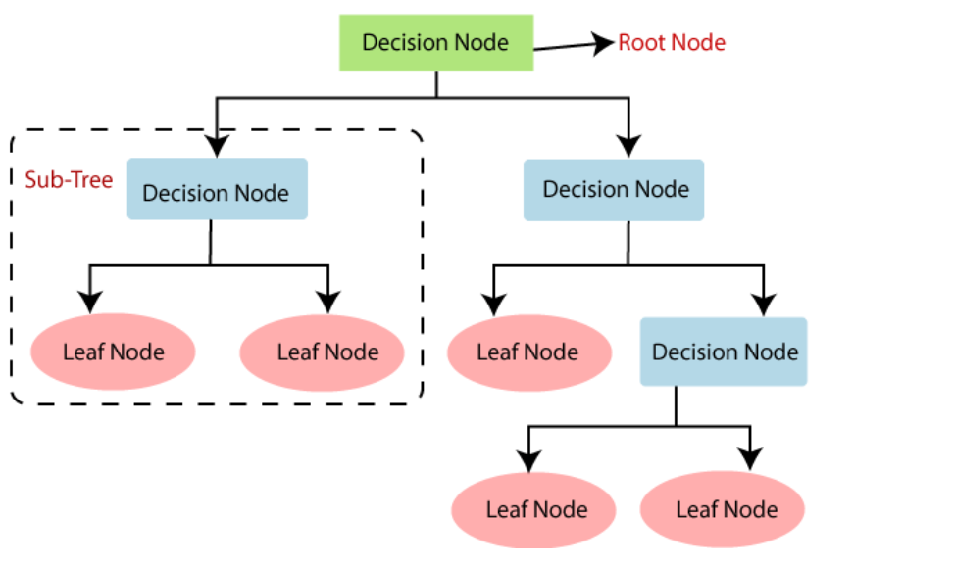
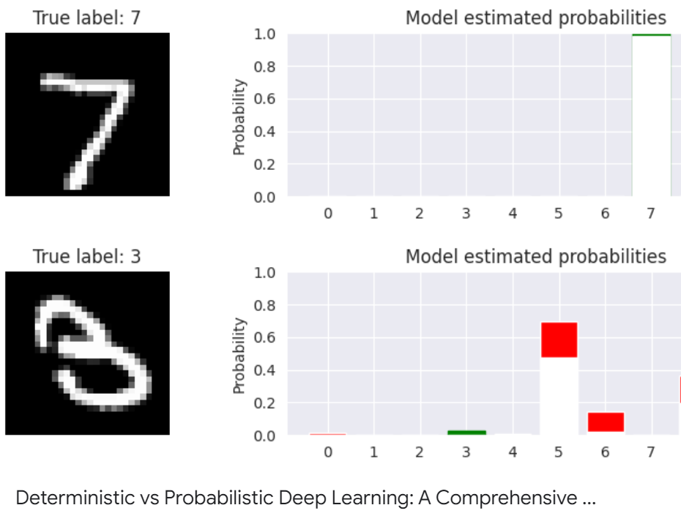
Objectives
AI Goals
Understanding
Decision Making
Learning
Problem Types
Generative vs Discriminative
Probabilistic vs Deterministic
“Decision Tree Classification Algorithm”, Javapoint.com
Towards Data Science
AI For Science
Notes:
AI Goals
AI has three main goals to achieve human-like intelligence:
Understanding:
AI systems need to understand information to process and make sense of the world around them.
For example, AI can understand spoken language (like Siri) or recognize objects in pictures (like facial recognition in cameras).
Decision Making:
After understanding the information, AI systems must make decisions based on what they know.
For instance, a self-driving car uses AI to decide when to stop, turn, or accelerate based on road conditions.
Learning:
AI gets better over time by learning from data and experiences.
Machine learning allows AI systems to improve their performance without being specifically programmed to do so.
Example: A recommendation system (like Netflix) learns your preferences and suggests shows you might like.
Problem Types
AI deals with various types of problems. Here are two important ways AI approaches problems:
Generative vs Discriminative Models:
Generative Models:
These models can generate new data based on what they have learned.
Example: An AI that can create realistic images of cats by learning what cats look like.
Generative models can learn the patterns in data and create new examples from those patterns.
Discriminative Models:
These models focus on distinguishing between different categories of data.
Example: An AI that can tell whether a picture contains a cat or a dog.
Discriminative models classify data by finding differences between objects or patterns.
Probabilistic vs Deterministic Approaches:
Probabilistic:
In probabilistic AI, decisions are based on probability or chance.
AI doesn't give a definite answer but says how likely something is to happen.
Example: AI predicting the weather might say there's a 70% chance of rain tomorrow.
Deterministic:
In deterministic AI, the system follows a set of exact rules to make decisions.
There’s no guesswork or probability; the outcome is always certain if given the same input.
Example: A calculator uses deterministic methods because 2 + 2 will always equal 4.

Slide 8
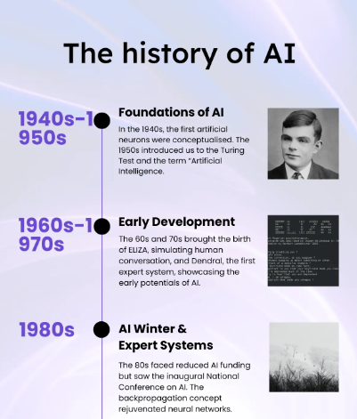
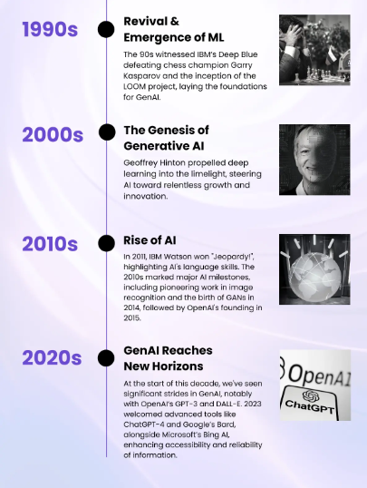
History of AI
1950’s “Turing Test”
“Perceptron” First Step Function
1965 Expert systems
1984 AI Winter
(Calls9 Insights, 2024)
“History of AI Timeline”, Source: Calls9 Insights, https://www.calls9.com/blogs/the-history-of-ai-a-timeline-from-1940-to-2023
AI For Science
Notes:
More AI History
1950s: The "Turing Test"
Alan Turing: A British mathematician, often considered the father of computer science.
Turing Test: Turing proposed a way to measure whether a machine could think like a human.
The test involves a human asking questions to both a machine and another human. If the human can’t tell which is which, the machine is said to have passed the Turing Test.
This concept was important because it asked, "Can machines think?"—a key question in AI.
1958: "Perceptron" – First Step Function
Perceptron: One of the earliest types of neural networks, created by Frank Rosenblatt.
It was a simple model designed to mimic how the brain works by simulating how neurons (brain cells) process information.
The perceptron could learn to recognize patterns in data, such as simple images or numbers.
Step Function: The perceptron used a mathematical rule called a "step function" to decide whether a certain input should be classified into one category or another.
This was a foundational concept for modern AI, laying the groundwork for more advanced machine learning and neural networks.
1965: Expert Systems
Expert systems: A type of AI designed to mimic human experts in specialized fields, like medicine or engineering.
These systems used if-then rules to solve complex problems and make decisions.
Example: An expert system could diagnose a medical condition based on symptoms, much like a doctor would.
How they worked: They contained a knowledge base of facts and rules and used an inference engine to apply these rules to new situations.
Though limited, expert systems were an important milestone in AI because they could handle tasks that previously only highly trained humans could do.
1984: AI Winter
AI Winter: A period during the 1980s when interest and funding in AI research dropped significantly.
This happened because early AI systems couldn’t live up to the high expectations people had for them. The technology wasn't advanced enough, and AI systems were too slow or limited.
Why it mattered: Many thought AI was a failure during this time, leading to less investment and research. However, the ideas developed during this time (like neural networks and machine learning) would later become crucial for the AI boom in the 2000s.
The "winter" eventually ended when computing power increased and new breakthroughs, like the development of powerful algorithms, reignited interest in AI.

Slide 9
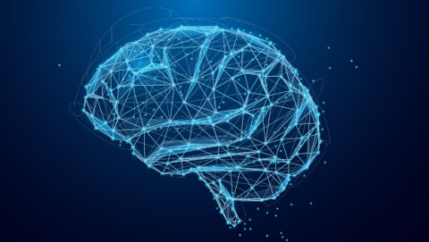


Machine Learning (ML)
AI
Subset of AI
Statistics - the nuts and bolts of AI
Algorithms
≠
≠
Machine Learning is how you determine the underlying function that solves a problem.
AI uses the functions solved by machine learning methods to make decisions.
≠
Robotics/Systems
Machine Learning/ Statistics
3-robot.jpg
cio_ai_intelligence_idea.png
711pTh86caS.jpg
AI For Science
Notes:
Machine Learning (ML)
1. Subset of AI
Machine Learning (ML) is a branch of AI:
While AI is the broad field focused on making machines intelligent, ML specifically focuses on how machines can learn from data and improve over time.
Example: AI is like a general brain, while ML is the learning process that makes that brain smarter with experience.
How it fits into AI:
Machine learning is used to find patterns in data and come up with solutions to specific problems.
AI then takes those solutions and applies them to make decisions.
2. Statistics – The Nuts and Bolts of AI
Statistics is a key part of ML:
Machine learning relies on statistics to analyze data, find patterns, and make predictions.
Statistics help machines determine how likely something is, like predicting the weather or the outcome of an event.
Why statistics matter:
In AI, machines often deal with uncertainty (like guessing how many people will buy a product next month).
Statistics help them figure out the most probable outcome based on the data they’ve learned from.
3. Algorithms
Algorithms are the instructions that tell a computer what to do.
In machine learning, an algorithm is a set of rules or steps the machine follows to learn from data and solve a problem.
Example: If you’re teaching an AI to recognize pictures of dogs, the algorithm would define how the AI looks at different features in the images to decide if it's a dog or not.
Types of algorithms:
Supervised Learning: The algorithm learns from labeled data (where the correct answer is provided).
Unsupervised Learning: The algorithm looks for patterns without being told the correct answer.
Reinforcement Learning: The algorithm learns by receiving rewards or penalties for actions it takes.
4. Machine Learning is How You Determine the Underlying Function That Solves a Problem
In machine learning, the goal is to find the hidden relationship or pattern (called the "underlying function") that explains the data.
For example, if you have data on students’ study hours and test scores, machine learning can find a function that predicts future test scores based on how many hours a student studies.
How it works:
You give the machine a lot of examples (data), and it tries to find a rule or function that explains the pattern.
Once the machine finds that function, it can use it to predict future outcomes or make decisions.
5. AI Uses the Functions Solved by Machine Learning Methods to Make Decisions
After machine learning finds the best function to explain a problem, AI systems use that function to make decisions.
Example: A machine learning model might learn how to predict whether an email is spam or not. AI uses that information to automatically sort your email into "Inbox" or "Spam."
The relationship:
ML = Figures out the solution or pattern.
AI = Uses that solution to take action and make decisions in real-world situations.

Slide 10

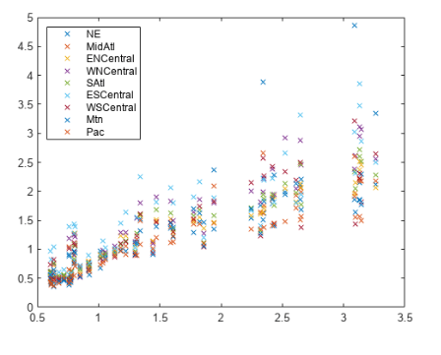
Machine Learning (ML)
So what makes something a machine learning algorithm?
You need an input that is machine readable
You need an output that is machine readable
You need to have a reasonable belief that there could be a mathematical function connecting or delineating data between the input and output.
You need some sort of mathematical construct that can be tuned to represent the relationship between the input and the output
You need a way to tune that mathematical construct to fit the relationship between input and output.
Example: TikTok Shorts
Multivariate Linear Regression, Mathworks
AI For Science
Notes:
What Makes Something a Machine Learning Algorithm?
You need an input that is machine-readable:
Input: This is the data you give to the machine learning algorithm to learn from.
The data has to be in a format that the computer can understand and process.
Examples of machine-readable inputs:
Text (like a social media post).
Numbers (like test scores).
Images (like pictures of cats).
You need an output that is machine-readable:
Output: This is the result or prediction that the machine learning algorithm generates.
The output also needs to be something the machine can process and use.
Examples of machine-readable outputs:
A prediction (like “Is this email spam?”).
A classification (like “This is a picture of a dog”).
A recommendation (like suggesting a new video to watch).
You need to have a reasonable belief that there could be a mathematical function connecting or delineating data between the input and output:
Mathematical function: The idea behind machine learning is that there’s often a pattern or relationship between the input data and the output result.
For example, the number of hours you study (input) could be related to your test score (output). Machine learning tries to find that hidden pattern.
Belief in a connection: You have to think that there’s some kind of mathematical connection between the input and output, even if it’s not obvious at first.
You need some sort of mathematical construct that can be tuned to represent the relationship between the input and the output:
Mathematical construct: This refers to a model or equation that the machine learning algorithm uses to represent the relationship between input and output.
Example: If you have data on how much people like certain TikTok videos, a model could represent the relationship between the video's features (input) and how much it’s liked (output).
The model is flexible, meaning it can be adjusted to better fit the data.
You need a way to tune that mathematical construct to fit the relationship between input and output:
Tuning: The algorithm needs to be trained using data to adjust the model so it accurately represents the relationship between input and output.
This is done by adjusting parameters in the model until it makes good predictions.
Example: In the TikTok case, the algorithm might be tuned to show certain types of content (like funny videos) based on what people engage with more.
Example: TikTok Shorts
How TikTok uses machine learning:
TikTok uses machine learning to recommend videos (like TikTok Shorts) that it thinks you’ll enjoy.
Input:
The algorithm looks at things like:
What videos you’ve liked or commented on.
How long you watch a video before scrolling.
Output:
Based on the input data, the algorithm predicts what types of videos you’re most likely to watch and enjoy.
The mathematical function:
There’s a relationship between the features of videos (like topic, length, or creator) and your engagement (liking, commenting, or watching).
The machine learning model finds that pattern and uses it to suggest more videos.
Tuning the algorithm:
As you keep watching videos, the algorithm keeps learning from your behavior and improving its recommendations by adjusting its predictions based on new data.

Slide 11

Why would I use Machine Learning (ML)?
Is the time/money to collect the data and train the model going to outcompete the current solution in:
Monetary cost
Time cost
Do we not currently have a solution to the problem but have initial features that relate to the problem?
Is there a meta research question regarding the limitations of the models?
Is the accuracy potential of the model not match with what is needed?
Ex of misuse: Using ML to determine the color of something. We can use the encoded data in the image file much more quickly.
Ex of correct use: Using a 95% accurate ML to identify plants for a hobbyist botany nature walk.
Ex for misuse: Using a 95% accurate ML to identify non-toxic plants you can eat.
Don’t be a hammer (solution) looking for a nail (problem)
https://www.yishizuo.com/dont-be-a-hammer-looking-for-a-nail-3/
AI For Science
Notes:
Why Would I Use Machine Learning (ML)?
Is the time/money to collect the data and train the model going to outcompete the current solution in:
Monetary cost:
Before using machine learning, you need to ask: Is it worth the money?
Collecting data and training a machine learning model can be expensive.
Example: Is it cheaper to use ML, or is there another solution that costs less?
Time cost:
Training a machine learning model also takes time—from gathering data to fine-tuning the algorithm.
You should ask: Will using ML save more time than the current method?
Do we not currently have a solution to the problem but have initial features that relate to the problem?
No existing solution:
Machine learning is useful when there’s no good solution to a problem yet, but you have data that might help solve it.
If you know some features (like patterns or variables) that could help, machine learning can use them to create a solution.
Example: You may not have a way to identify rare plants, but you have data on their features (size, leaf shape, color).
Is there a meta research question regarding the limitations of the models?
Understanding the limits of ML:
Sometimes researchers want to use machine learning to test its boundaries and understand its limitations.
This could be part of a bigger research question where you’re asking: “How well can machine learning handle this problem?”
Example: You might use machine learning in a research project to see where it struggles or what kinds of problems it can’t solve well.
Is the accuracy potential of the model not matching what is needed?
Accuracy issues:
Sometimes machine learning models aren’t accurate enough for the task at hand.
If the model is only, say, 95% accurate, it might not be good enough, depending on what you need.
Example: If you’re identifying dangerous or poisonous plants, even a 95% accurate model could be too risky because it’s not 100% reliable.
Examples of Misuse and Correct Use of ML
Example of Misuse:
Using ML to determine the color of something:
Machine learning shouldn’t be used for tasks that can be solved much more easily.
Example: Using ML to figure out the color of something from an image is unnecessary because the color data is already stored in the image file. You can read the color code without needing an ML model.
Why it’s a misuse: ML takes too much time and effort for something that can be done quickly and cheaply using existing methods.
Example of Correct Use:
Using a 95% accurate ML model to identify plants for a hobbyist on a nature walk:
If you’re a plant hobbyist on a nature walk, and you want to identify different plants, a 95% accurate model is good enough.
Even if it’s not perfect, the consequences of being wrong are low risk—you just want to learn more about the plants.
Why it’s a good use: The task is simple, and the stakes aren’t high, so the ML model works well for this situation.
Example of Misuse:
Using a 95% accurate ML model to identify non-toxic plants you can eat:
If the machine learning model is only 95% accurate, it’s too risky to use it to identify plants that are safe to eat.
A mistake here could be dangerous or life-threatening.
Why it’s a misuse: In this case, 95% accuracy isn’t good enough because the consequences of being wrong are too serious.

Slide 12
Structure of AI/Machine Learning
Problem Classes
Types of Learning
ML Algorithms/Models
What am I trying to do?
Problem Types
Generative vs Discriminative
Probabilistic vs Deterministic
Problem Classes
Regression
Classification
Clustering
Association
…
How am I trying to learn?
Learning Types
Supervised
Unsupervised
Self-supervised
Semi-Supervised
Each one is dependent on:
What is the model input?
What is the model output?
Which of the I/O does my model get to train on?
What construction am I using to guide my learning?
More on this in the coming weeks…
Your function’s best attempt
Actual - “Ground Truth”
AI For Science
Notes:
Sky-High View of Machine Learning and AI
AI Tries to Solve Problems
At its core, the goal of AI is to solve problems.
These problems can range from recognizing images to predicting future events.
AI is about finding smart solutions to real-world challenges.
Different Types and Classes of Problems
The problems AI tries to solve fall into different types or classes.
Examples of problem types:
Classification: Sorting data into categories (like deciding if an email is spam or not).
Regression: Predicting a number based on patterns in data (like predicting housing prices).
Clustering: Grouping similar items together (like organizing news articles by topic).
Each type of problem requires a specific approach to find the best solution.
Different Learning Methods for Different Problem Classes
Each problem class has different learning methods that are used to solve it. These learning methods are ways the AI or machine learns from data.
Common learning methods include:
Supervised Learning: Learning from labeled data (like using historical sales data to predict future sales).
Unsupervised Learning: Learning patterns in data without knowing the correct answer beforehand (like finding groups of customers with similar shopping habits).
Reinforcement Learning: Learning through trial and error by receiving feedback from actions (like a robot learning to walk by getting rewards for successful steps).
Multiple Machine Learning Algorithms/Models for Each Learning Method
For each learning method, there are many machine learning algorithms or models that can be used to perform the task.
Why are there different models?
Different models are based on different mathematical ideas and might be better suited for certain problems.
Some models might work better in specific situations because they fit the problem’s structure better than others.
Example:
For predicting house prices, a linear regression model might be good, but for recognizing handwritten digits, a neural network might be better.
Models Represent Different Mathematical Constructs
Each machine learning model represents a different type of mathematical construct or approach to solving the problem.
Some models might use simple math (like straight-line equations), while others might use complex structures (like deep neural networks).
The choice of model depends on the problem’s complexity and the type of data you have.
Some Problems Are Solved Better by One Model Than Another
Not all models are equally good at solving every problem.
Some problems may be better solved by one model over another because of the way the model handles the data.
Example: If you want to predict a curved pattern (like the shape of a circle), using a simple linear model (which predicts straight lines) won’t work well. You need a more complex model that can handle curves.
Example: Learning the Function of a Circle
Imagine trying to teach a machine to learn the function of a circle. If you only allow it to use a single variate linear function (which can only draw straight lines), it won’t be able to represent a circle properly because circles are curved.
This shows how important it is to choose the right model for the task. A simple model may fail at solving more complex problems.
Summary:
AI tries to solve different types of problems using specific learning methods.
Each method has many algorithms and models to choose from because some models work better for certain problems than others.
Understanding which model fits the problem is key to successful machine learning, which will be discussed more in the coming weeks.

Slide 13
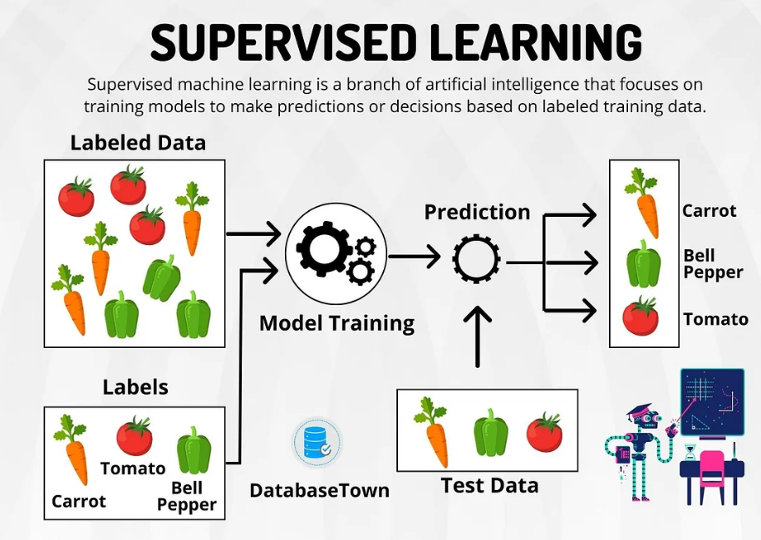
Types of AI Learning
■ Supervised
■ Unsupervised
■ Semi-Supervised
■ Self-Supervised
Learning Methods Demystified
Problem Type | Learning Method | Input/Output
Find the structure | Unsupervised | No ground truth
Fill in the blank | Self-supervised | Internal component ground truth
Fill in the pattern - “interpolate” | Supervised | External component ground truth
Grounded structure search | Semi-supervised | Limited ground truth
Ground truth: The “correct” answer
“Supervised Learning”, Medium.com
AI For Science
Notes:
Problem Types and Learning Methods
1. Unsupervised Learning
What it is: Learning without any labeled data or predefined categories.
Input/Output: You have data, but you don’t know the correct output categories.
Find the Structure: The goal is to discover patterns or groupings in the data on your own.
Example: Grouping customers based on their purchasing behavior without knowing in advance what the groups should be.
2. Self-Supervised Learning
What it is: Learning where the data provides its own labels or ground truth internally.
Input/Output: The system generates its own labels or rules from the data itself.
Fill in the Blank: The model learns by predicting parts of the data from other parts.
Example: Predicting the missing words in a sentence based on the surrounding words.
3. Supervised Learning
What it is: Learning with labeled data where the correct answers are provided.
Input/Output: You have data with known labels or categories.
Fill in the Pattern: The model learns by finding patterns between input data and the given labels.
Example: Training a model to recognize cats and dogs from images where each image is labeled as either “cat” or “dog”.
4. Semi-Supervised Learning
What it is: Learning with a mix of labeled and unlabeled data.
Input/Output: Some data points have labels, while others do not.
Grounded Structure Search: The model uses the labeled data to help understand the structure and patterns in the unlabeled data.
Example: Using a small set of labeled images to help classify a larger set of unlabeled images.
5. Ground Truth
What it is: The actual, correct information or labels used as a reference in machine learning.
In Supervised Learning: Ground truth is the labeled data with known answers (e.g., images labeled as “cat” or “dog”).
In Unsupervised and Self-Supervised Learning: Ground truth is not used. Instead, patterns or rules are discovered without predefined answers.
Purpose: Helps evaluate the accuracy of the model by comparing its predictions against the known correct labels.
Summary:
Unsupervised Learning: No labels; discover patterns.
Self-Supervised Learning: Data provides its own labels; predict missing parts.
Supervised Learning: Uses labeled data; find patterns based on known labels.
Semi-Supervised Learning: Mix of labeled and unlabeled data; use labels to understand the structure of unlabeled data.
Ground Truth: The actual correct labels or information used to train and evaluate models.

Slide 14
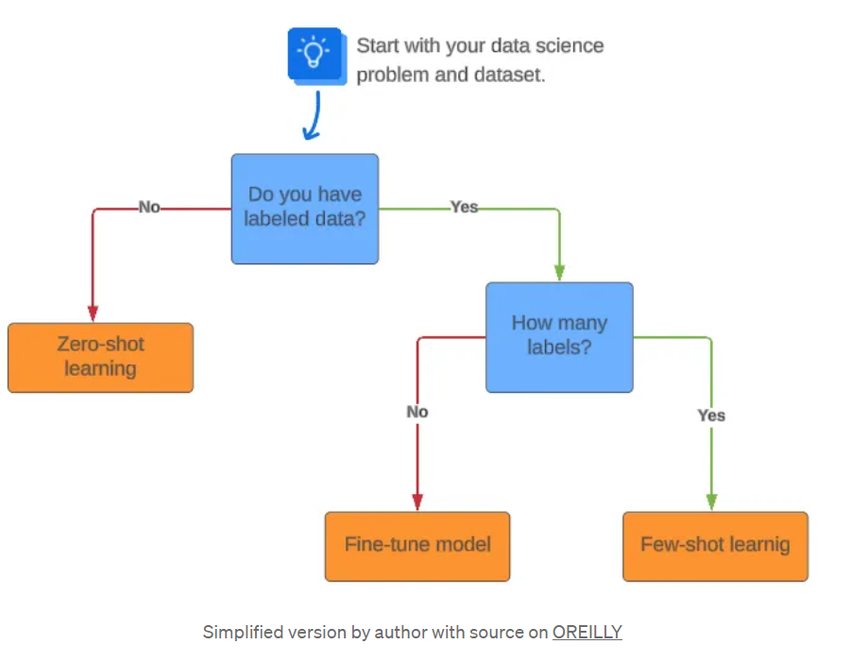
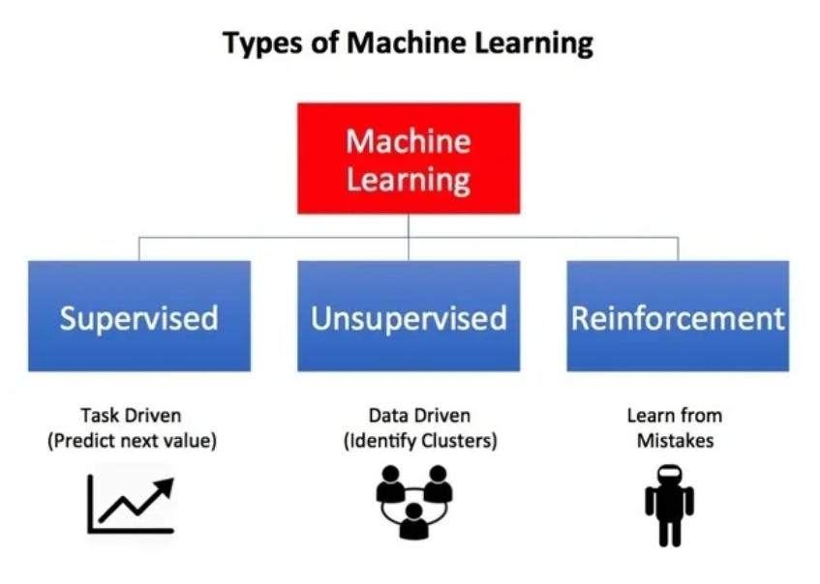
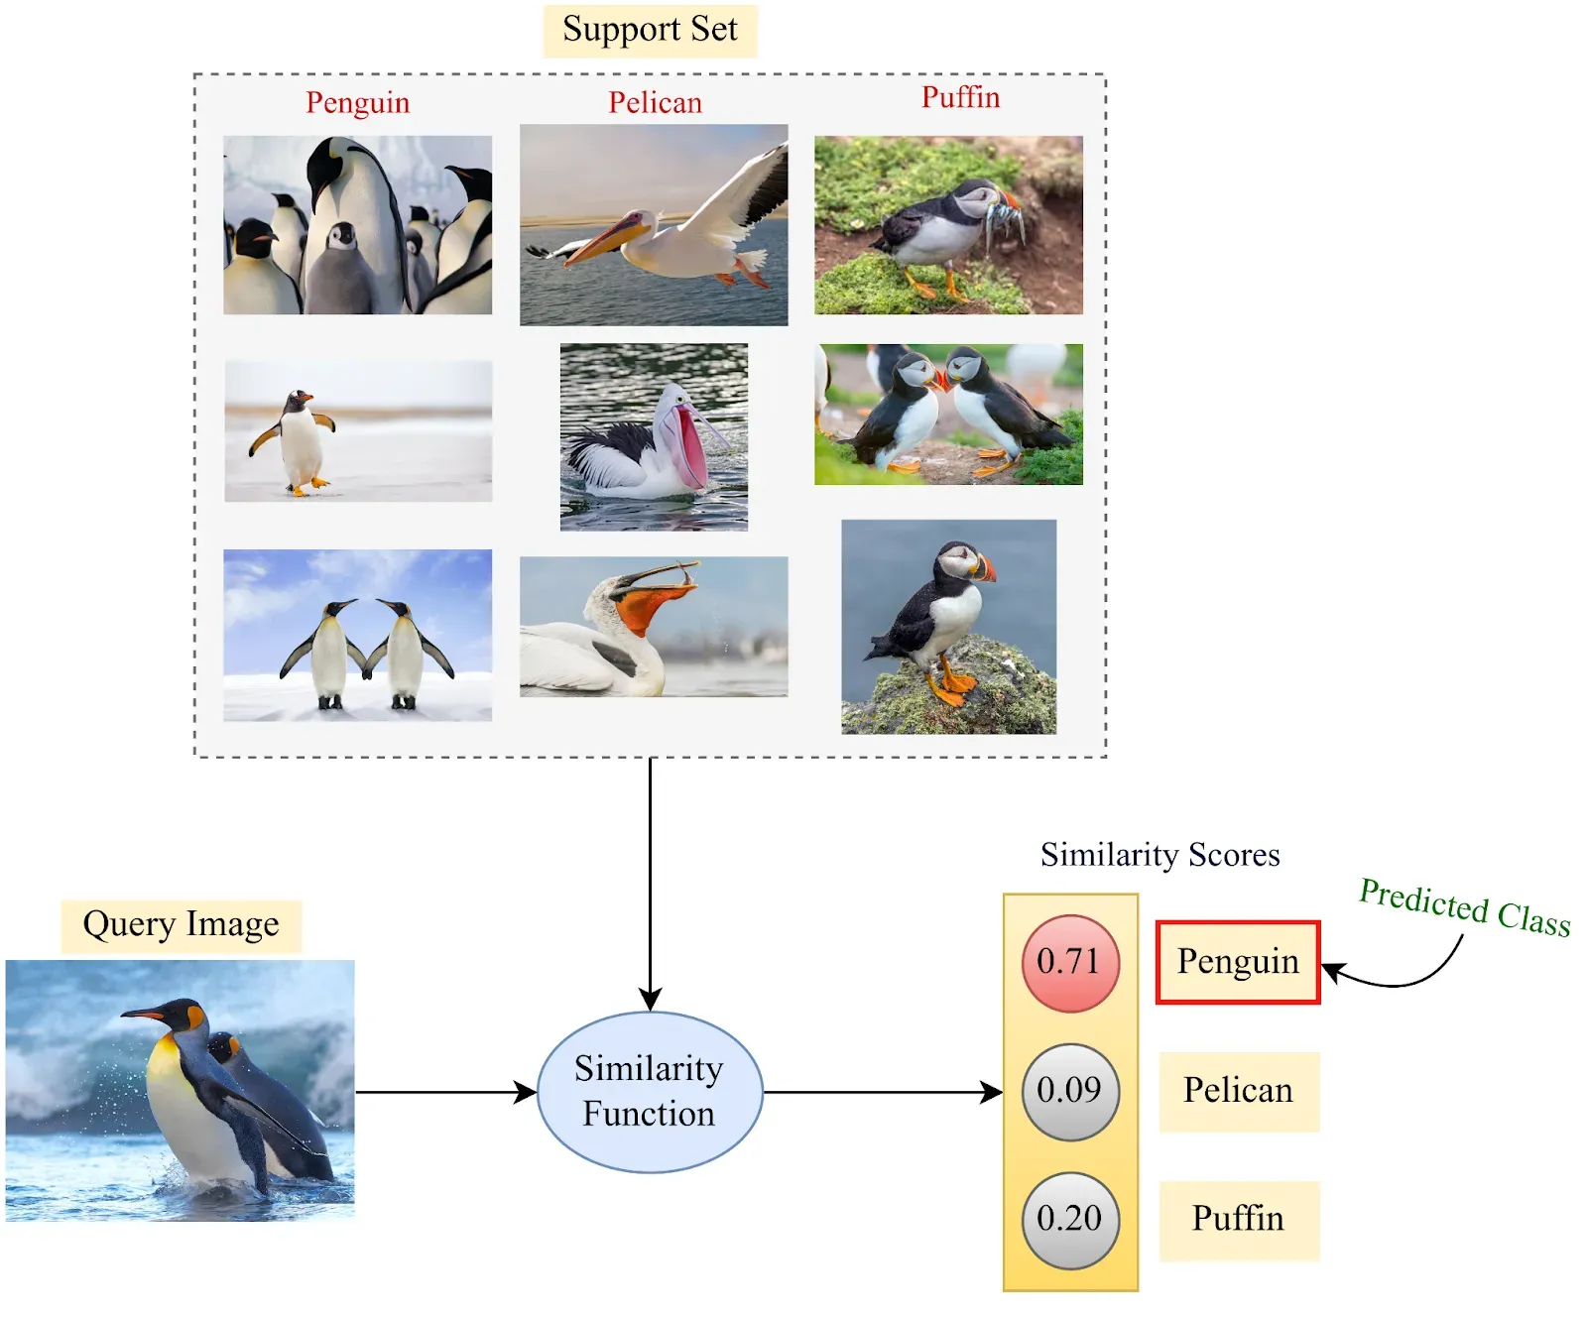
Types of AI Learning (Continued)
■ Reinforcement Learning
■ Few Shot Learning
“Few and Zero Shot Learning”, Medium.com“
“Types of Machine Learning”, Medium.com
image-625.webp
AI For Science
Notes:
1. Reinforcement Learning (RL)
What it is:
Reinforcement Learning is a type of learning where an AI learns by interacting with its environment and receiving feedback based on its actions.
It’s often described as “toddler learning” because, like a toddler, the AI learns by trial and error, trying things out and getting rewards or penalties based on what it does.
How it works:
The AI takes actions and learns which actions are good (rewarded) or bad (penalized).
Over time, it learns to repeat actions that lead to rewards and avoid actions that lead to penalties.
Each attempt at a task builds on the previous experience, improving the AI’s performance.
Where it’s used:
Robotics is a common field where RL is used because robots often need to interact with the world and learn how to accomplish tasks, like navigating a room or picking up objects.
Example: Imagine a robot trying to balance on two wheels. Each time it falls over, it receives a penalty, and when it stays balanced, it gets a reward. Over time, it learns how to stay balanced longer.
2. Few-Shot Learning (FSL)
What it is:
Few-Shot Learning is when an AI is trained to complete a task using only a few examples of how to do it.
This type of learning is important when there are limited data or examples available.
How it works:
The AI is shown just a few examples of a task (like identifying types of birds) and is expected to make predictions about new examples by comparing them to the ones it has seen.
Probabilistic learning: The AI doesn’t always know for sure, but it guesses based on how similar the new data is to what it has already learned.
Where it’s used:
Few-Shot Learning is useful when there isn’t a lot of training data available. It’s good for tasks like image recognition or classification where collecting large datasets might be difficult.
Example: If the AI is shown just a few images of different birds and then asked to identify a new bird image, it makes a prediction by choosing the bird that the new image most closely resembles. Even with limited examples, the AI makes a probabilistic guess.
Summary:
Reinforcement Learning (RL): The AI learns by interacting with its environment, making mistakes, and improving over time through feedback (used in robotics and real-world interaction).
Few-Shot Learning (FSL): The AI learns to perform tasks with just a few examples, often used when data is limited (like classifying bird species based on a small number of pictures).
These learning methods are more specialized than traditional supervised or unsupervised learning, offering powerful ways for AI to tackle complex or data-limited tasks.

Slide 15
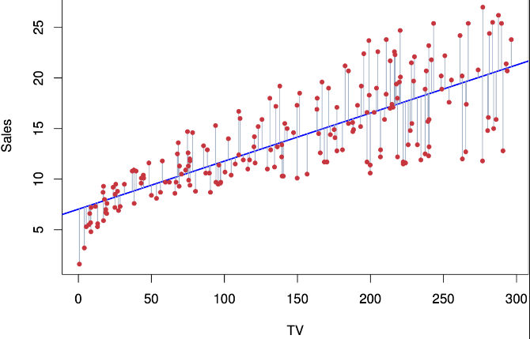
Problem Class - Regression
Very common in Supervised Learning
Linear Regression: y=mx+b
Variance
Bias
(Built In, 2024)
“Simple Linear Regression”, Stanford.edu, Stats 202
AI For Science
Notes:
1. What is Regression?
Regression is a type of problem in supervised learning where the goal is to predict a continuous outcome.
Supervised learning means you have labeled data where the correct answers are provided.
Example: Predicting the price of a house based on its features like size, location, and number of rooms.
2. Linear Regression: y = mx + b
Linear Regression is a simple form of regression.
The equation y = mx + b represents a straight line:
y is the output you want to predict (e.g., house price).
x is the input feature (e.g., house size).
m is the slope of the line (shows how much y changes with x).
b is the y-intercept (where the line crosses the y-axis).
How it works:
It tries to find the best line that fits the data points on a graph to make predictions.
Graph plotting: You plot the data points and draw a line that best represents the relationship between the input and output.
3. Variance and Bias
Variance:
Refers to how much the model’s predictions change when using different sets of training data.
High variance means the model is too complex and might fit the training data too closely, leading to poor performance on new data (overfitting).
Bias:
Refers to how much the model’s predictions differ from the actual results.
High bias means the model is too simple and might not capture the underlying patterns well (underfitting).
Balancing variance and bias:
You want a model with low variance and low bias to make accurate predictions.
Sometimes, more data or simplifying the model can help reduce variance and bias.
4. Types of Regression Modeling
Linear Regression:
The simplest form, using a straight line to model the relationship between input and output.
Multiple Linear Regression:
Extends linear regression to use multiple input features (e.g., predicting house price using size, location, and number of rooms).
Multivariate Regression:
Models relationships between multiple input features and multiple outputs.
Polynomial Regression:
Uses a polynomial (curve) rather than a straight line to model more complex relationships.
5. Importance of Regression Modeling
Fundamental concept: Regression modeling is a key technique in supervised machine learning.
Forecasting results: It helps in predicting future values based on known data.
Finding patterns: It’s useful for understanding how different variables affect each other.
6. Fine-Tuning the Model
Refining Results:
If the model’s predictions are not accurate, you might need to adjust the algorithm or use more data.
Fine-tuning involves tweaking the model to improve its performance by addressing issues like high variance or bias.
Example: If the model predicts house prices poorly, you might need to add more features or choose a more complex model to get better predictions.
Summary:
Regression is used to predict continuous values and is fundamental in supervised learning.
Linear Regression uses a straight line to represent the relationship between input and output.
Variance and bias help measure model accuracy and need to be balanced for effective predictions.
Different types of regression (like multiple or polynomial) can model more complex relationships.
Fine-tuning helps improve the accuracy of predictions by adjusting the model or adding more data.

Slide 16
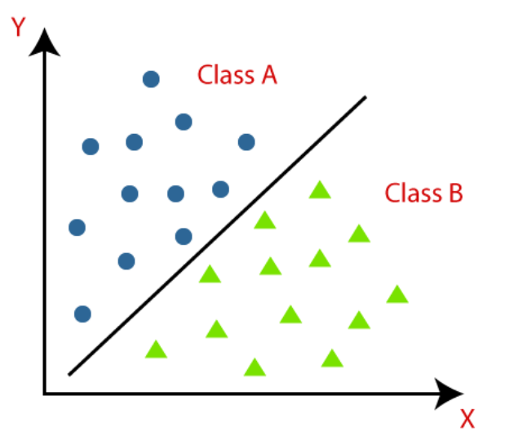
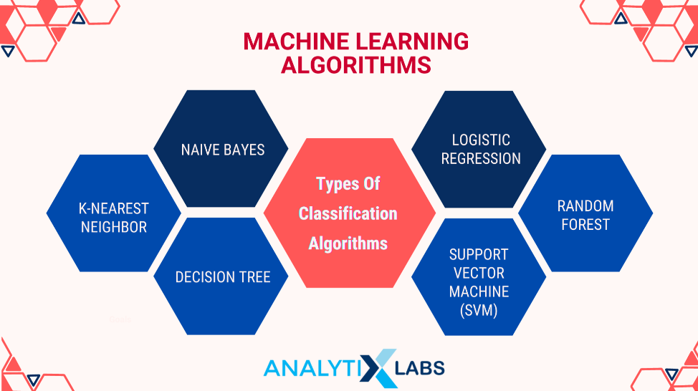
Problem Class - Classification
Common in Supervised Learning
Some ground truth training data.
Seek patterns to separate the dataset
“Classification Algorithm”, Javapoint.com
“Classification Algorithms, Analytixlabs.in.co
AI For Science
Notes:
Problem Class: Classification
1. What is Classification?
Classification is a type of problem in supervised learning where the goal is to assign inputs to specific categories or classes.
Unlike regression, which predicts a continuous value, classification predicts a discrete label.
Example: Determining if an email is spam or not spam.
2. Classification vs. Regression
Regression: Finds a specific value (like predicting house prices with y = mx + b).
Classification: Finds a category or group (like determining if an email is spam or not spam).
Instead of predicting a number, classification decides if something falls into one category or another (e.g., greater than or less than a threshold).
3. How Classification Works
Training Data: Uses labeled data where each input already has a known category or class.
Patterns: The model seeks patterns in the data to separate or distinguish between different classes.
Example: Scanning a photo of a leaf to determine the type of tree it belongs to.
4. Applications of Classification
Image Recognition: Identifying objects or types of objects in images (e.g., classifying different types of animals or plants).
Text Classification: Sorting text into categories (e.g., spam detection in emails or sentiment analysis of reviews).
Spell Checkers: Spell-check is an example of classification. It checks each word against a dictionary (a set of correct words) and identifies whether it’s correctly spelled or not.
5. Classification Models and Clustering
Classification Models:
Simple Models: Can be quite effective for visual recognition tasks when there’s enough data.
Examples: Logistic Regression, Decision Trees, and Support Vector Machines.
Clustering:
Related to classification but differs in that it groups data into clusters without predefined classes.
Example: Grouping customers based on purchasing behavior without knowing the specific groups beforehand.
6. Multi-Classification
Multi-Class Classification:
Involves classifying inputs into one of multiple categories.
Example: Identifying different types of fruits (apple, banana, orange) rather than just two categories.
7. Visual Recognition
Classification results can often be visualized and interpreted easily.
Simple models with enough data can recognize patterns in images or text and classify them accurately.
Summary:
Classification assigns inputs to specific categories or classes rather than predicting a continuous value.
It uses labeled training data to find patterns that separate different classes.
Applications include image recognition, text classification, and spell-checking.
Classification can involve multi-class classification and is closely related to clustering, which groups data without predefined classes.

Slide 17
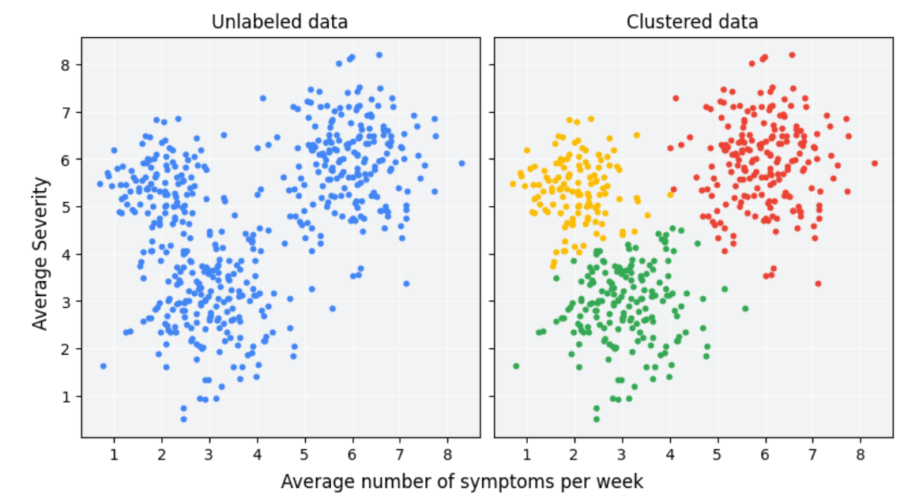
Problem Class - Clustering
Most often Unsupervised Learning
No ground truth training data. May not even know how many clusters.
Seek patterns to separate the dataset.
(Google, 2024)
(Google, 2024)
AI For Science
Notes:
Problem Class: Clustering
1. What is Clustering?
Clustering is a type of problem in unsupervised learning where the goal is to group similar data points together into clusters.
Unlike classification, clustering doesn’t use predefined labels or categories. Instead, it looks for patterns or similarities in the data.
Example: Grouping customers based on purchasing behavior without knowing in advance what the groups will be.
2. Clustering vs. Classification
Classification:
Works with labeled data where categories are predefined.
The goal is to assign new data points to these predefined categories.
Example: Sorting emails into spam or not spam.
Clustering:
Works with unlabeled data where no categories are predefined.
The goal is to discover natural groupings or patterns in the data.
Example: Grouping similar articles on a news website without knowing beforehand what the topics will be.
3. How Clustering Works
No Ground Truth: There’s no pre-labeled data or known number of clusters.
Finding Patterns: The algorithm looks for patterns and similarities to group data into clusters.
Inductive Learning: The model learns patterns from the data itself rather than from predefined labels.
4. Applications of Clustering
Medicine:
Drug Discovery: Clustering can help identify groups of patients with similar responses to a drug or predict potential side effects.
Example: Grouping patients based on genetic data to find patterns related to disease susceptibility.
Marketing:
Customer Segmentation: Clustering can group customers based on purchasing behavior to tailor marketing strategies.
Example: Identifying different customer segments for targeted advertising.
5. Power of Clustering
Summarizing Data: Clustering helps in summarizing large datasets by finding similarities and grouping similar items.
Discovering Relationships: It can reveal potential correlations or relationships that were not obvious initially.
6. Comparing Classification and Clustering
Purpose:
Classification: Focuses on identifying or categorizing individual data points into predefined classes.
Clustering: Focuses on discovering groups or clusters within the data based on similarities.
Real-Life Use Cases:
Classification Use Case: Email filtering to categorize messages as spam or important.
Clustering Use Case: Market segmentation to group customers based on purchasing behavior for targeted marketing.
Summary:
Clustering is an unsupervised learning method used to group similar data points without predefined labels.
It is useful for discovering patterns, relationships, and groupings in large datasets.
Unlike classification, clustering does not rely on labeled data and is often used in fields like medicine and marketing to analyze and summarize data.

Slide 18
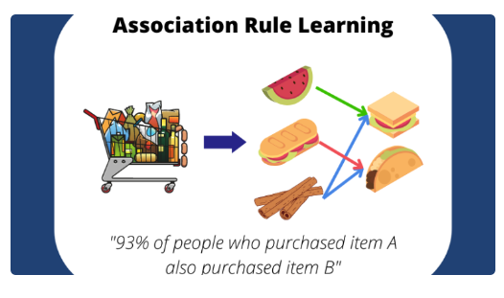
Problem Class - Association
Unsupervised Learning
Learning pattern based rules
Seeks relationships in data
“Association rule Learning”, Poornima Devi
AI For Science
Notes:
Problem Class: Association
1. What is Association?
Association or association rule-based learning is an unsupervised learning method that finds relationships or patterns in data without needing predefined labels.
The goal is to discover rules that describe how different items or features in the data are related to each other.
Example: Finding out that people who buy bread often also buy milk.
2. How Association Works
Pattern-Based: It identifies patterns or rules in the data, rather than working with labeled examples.
Unsupervised: Unlike supervised learning, association does not rely on labeled data but rather seeks to uncover relationships from the data itself.
Rules: The output is a set of rules or patterns that describe how different items are associated.
3. Applications of Association
Marketing:
Product Recommendations: Retailers use association rules to recommend products. For example, if customers often buy bread and milk together, the store might recommend milk when a customer buys bread.
Example: Market Basket Analysis: This technique finds out which items are frequently bought together.
Groceries:
Finding Trends: Stores analyze purchase patterns to understand what products are often bought together. For instance, bread and milk might be frequently purchased in the same transaction.
4. Statistical Nature of Association
Correlation, Not Causation: The rules found by association are statistical and indicate relationships but do not necessarily imply causation.
Example: If 90% of customers who buy bread also buy milk, it might be due to an external factor like a weather event rather than a direct cause.
5. Data Mining Examples
Groceries: Retailers use association rule learning to improve product placement and promotions based on purchase patterns.
Example: Discovering that people who buy chips often buy soda, so the store places these items near each other.
6. Interpreting Results
Context Matters: While association rules reveal patterns, it’s important to consider the broader context. Statistical trends might be influenced by factors outside the immediate dataset.
Example: A pattern of buying bread and milk together could be influenced by external factors like a special promotion or weather conditions.
Summary:
Association is an unsupervised learning method that finds relationships or patterns in data by discovering rules rather than using labeled examples.
It is useful for applications like product recommendations and market analysis.
The results are statistical correlations, not causal relationships, and should be interpreted within a broader context.

Slide 19
Class Project
Purpose: To give you hands on experience in planning a machine learning study around a scientific problem.
Throughout the course you will have 5 project checkpoints due.
Problem Selection
Data
Models
Opportunities/Limitations
Final Presentation - 5-10 minute video about your project.
All checkpoint assignments are already available and you can complete them early if you want!
First component due next Tuesday - Use the Google Classroom question thread to ask me about your project ideas, or set up a meeting with me through jessica.freeze@coniferpoint.com
AI For Science

Slide 20
Honesty Policy
Working with the other students is encouraged - But copying (from students or the internet) is not.
Homework and quizzes for this class have been designed with your other school and extracurricular obligations in mind…these assignments should not take long to do.
Assignments are meant to make you think and make sure you are paying attention/spending more time with the material so you remember it better.
Any resource you use, including AI bots, needs to be cited (we don’t care what format - MLA, APA, “I used this <url> and got <this information> from it”).
AI For Science

Slide 21
Question Time!
AI For Science

Slide 22
References
“Regression in Machine Learning: Definition and Examples.” Built In, 1 Aug. 2024, builtin.com/data-science/regression-machine-learning.
“The History of AI: A Timeline from 1940 to 2023 + Infographic.” Calls9 Insights, www.calls9.com/blogs/the-history-of-ai-a-timeline-from-1940-to-2023. Accessed 1 Sept. 2024.
Machine Learning for Science Team. (n.d.). Machine Learning for Scientists. Introduction - Machine Learning for Scientists. https://ml-lectures.org/docs/introduction/introduction.html
“What Is Clustering? | Machine Learning | Google for Developers.” Google, Google, developers.google.com/machine-learning/clustering/overview. Accessed 4 Sept. 2024.
AI For Science

